Slide 1






Pengukuran Tingkat Demokrasi Menggunakan Metode Sentiment Analysis
Bandung, 23 Juni 2022
Nama : Nova Nurviana
Pembimbing : Prof. Dr. Ir. Jaka Sembiring, M. Eng
Penguji : Ir. Hendrawan M,Sc. , PhD
Dr. Tutun Juhana, S.T. , M.T
Dr. Kusprasapta Mutijarsa, S.T. , M.T
SCHOOL OF ELECTRICAL ENGINEERING AND INFORMATICS
BANDUNG INSTITUTE OF TECHNOLOGY

Slide 2


Slide 3







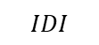
Pentingnya Pengukuran Tingkat Demokarasi
Untuk mengukur tingkat demokrasi di setiap provinsi
Sebagai landasan untuk penyusunan perencanaan politik
Sebagai bahan perbandingan dengan negara lain
$$IDI$$
Sebagai data pendukung penelitian

Slide 4
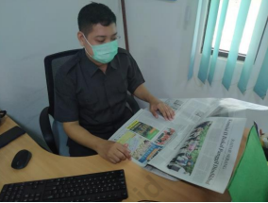
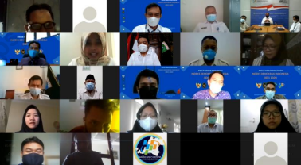
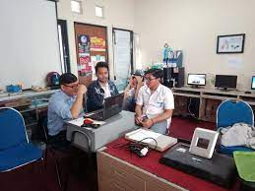
Indeks Demokrasi
Komputasi

Slide 5

Masalah:
Rentang Waktu antara Publikasi dengan Data Terakhir yang Digunakan
$\overline{x}$=2,3

Slide 6
Diperlukan metode lain untuk mengukur tingkat demokrasi, sehingga penyajian data lebih up to date

Slide 7

Literature Review
(Lutz and
du Toit, 2014)
(Grundler and
Krieger, 2021)
(Bashar, 2019)
(Marzagao,2017)
(Oliveira, 2019)
Measuring democracy from twitter using sentiment analysis
Using machine learning to conduct research about democracy indicator
Using Non Response Analysis to predict democracy value
Automated Democracy Score (PDF)
Sentiment Anlysis for government program

Slide 8
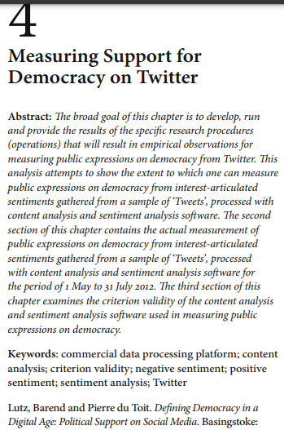
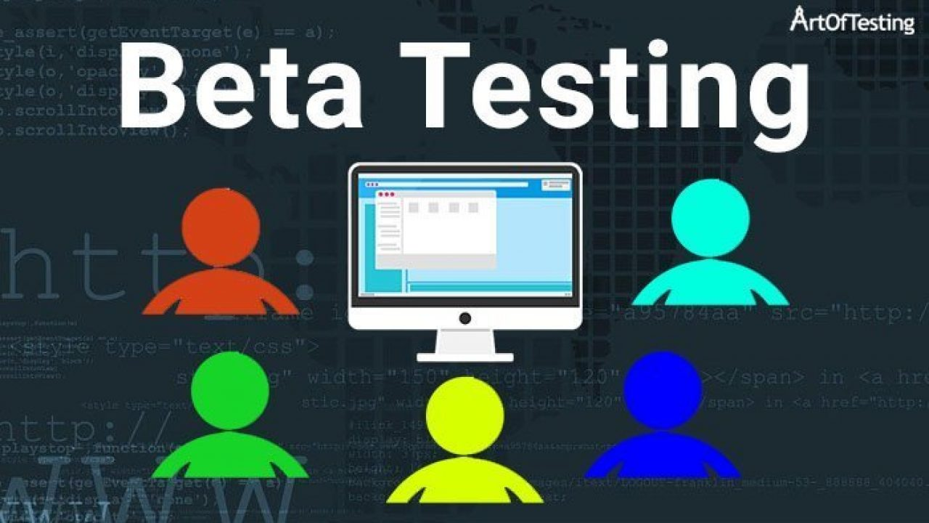


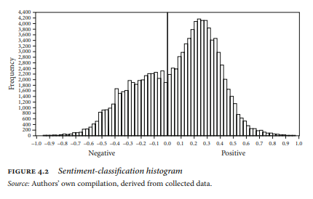
Literature 1

Slide 9

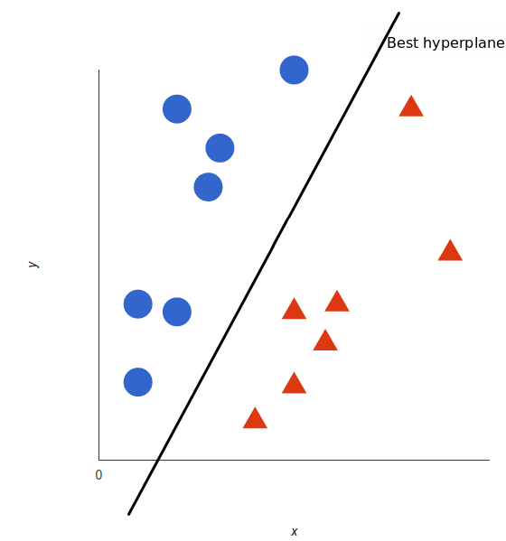
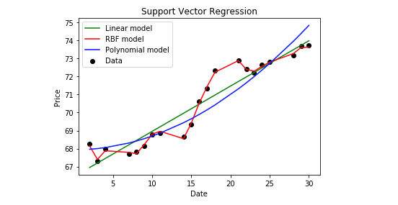
Literature 2

Slide 10
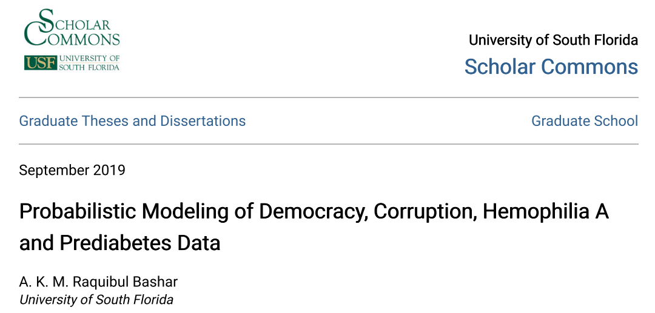
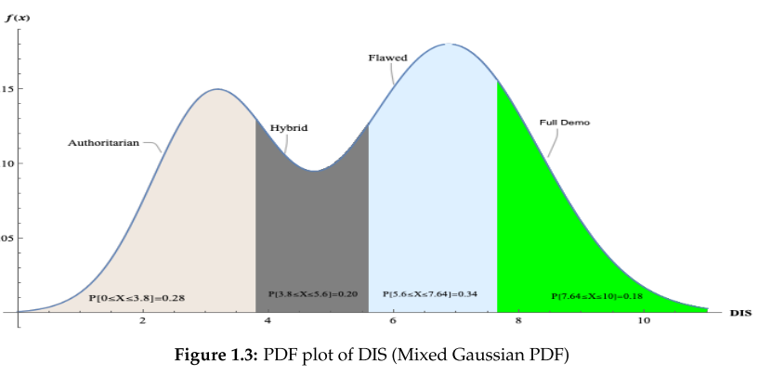
Literature 3

Slide 11
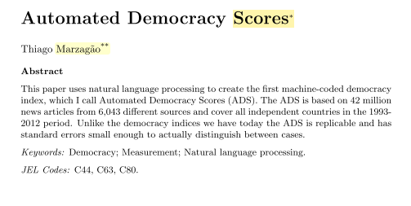


Literature 4

Slide 12

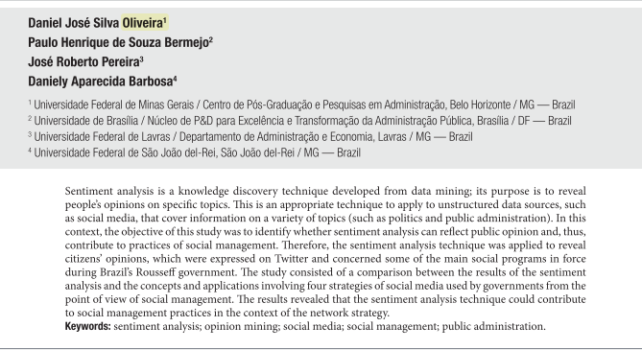



Literature 5

Slide 13


Indonesia Literature Map
Nurviana, 2022
Rahutomo, 2020
Huda, 2019
Measurement
Prediction

Slide 14

Hypothesis
Sentiment analysis can be used as an alternative method to measure democracy level

Slide 15
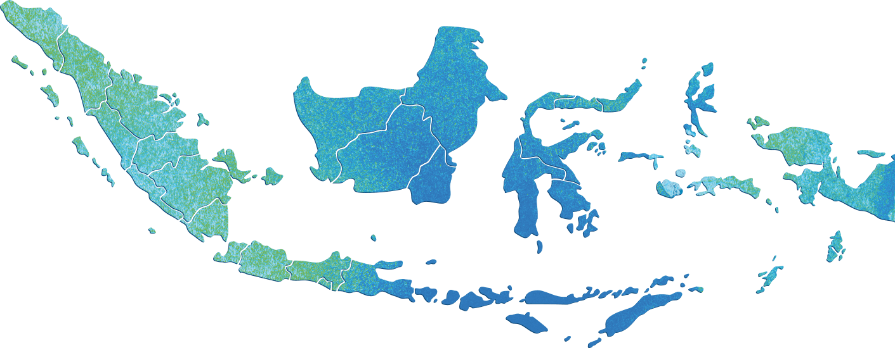
Online Newspaper
Karim and hasan in 2007
said that there is an increasing of online newspaper
Banyak
: >10
Sedang
: 4-10
Sedikit
: 2-3

Slide 16
Online Newspaper
Karim and hasan in 2007
said that there is an increasing of online newspaper
Banyak
: >10
Sedang
: 4-10
Sedikit
: 2-3

Slide 17
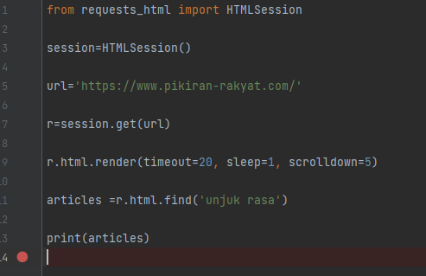
Collecting Data - Scraping

Slide 18

Tag/Key Words

Slide 19




Definition Sentiment Analysis
Wedhat W, 2014
Sentiment Analysis is a study to learn emotion computation, sentiment, and attitude that comes from text about certain topic
Montoyo A 2012
Sentiment Analysis is opinion digging, penggalian, review, appraisal extraction, opinion classification, sentiment classfification, attitude classification on certain topic

Slide 20
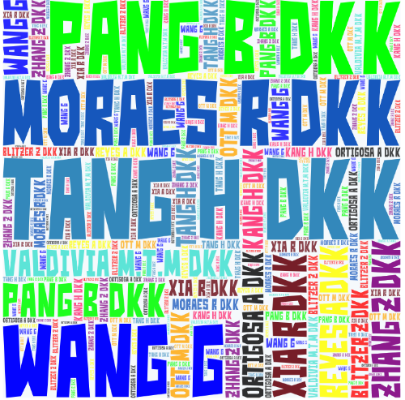
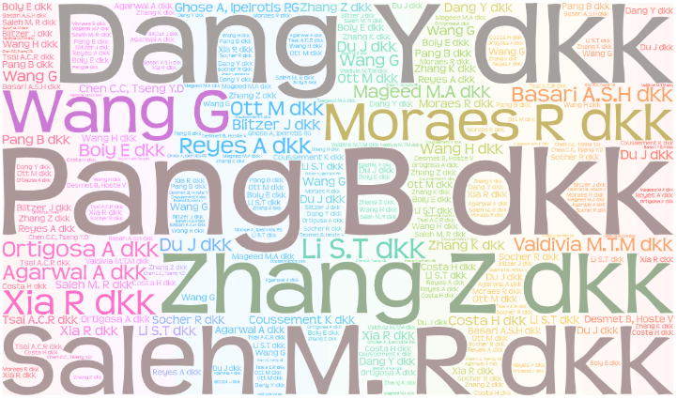
Classification Algorithm: Naïve Bayes dan SVM
SVM
Naïve Bayes

Slide 21


Classification Evaluation
Naïve Bayes
 | Precision | Recall | F1-Score | Support
Non Violance | 0.86 | 0.93 | 0.90 | 129
Violance | 0.92 | 0.84 | 0.88 | 121
Accuracy |  |  | 0.89 | 250
Macro avg | 0.89 | 0.89 | 0.89 | 250
Weighted avg | 0.89 | 0.89 | 0.89 | 250
01
 | Precision | Recall | F1-Score | Support
Non Violance | 0.86 | 0.93 | 0.90 | 129
Violance | 0.92 | 0.84 | 0.88 | 121
Accuracy |  |  | 0.89 | 250
Macro avg | 0.89 | 0.89 | 0.89 | 250
Weighted avg | 0.89 | 0.89 | 0.89 | 250
SVM
02
Notes:
© Copyright PresentationGO.com – The free PowerPoint and Google Slides template library

Slide 22
T-test Democracy Index vs Sentiment Analysis
Year | Democracy Index | Sentiment Analysis
2020 | 71,32 | 71,51
2019 | 69,09 | 71,57
2018 | 65,50 | 65,15
2017 | 68,78 | 70,49
2016 | 66,82 | 66,32
Statistics Canada, 2015,
“Index reflects percentage change”
Result: This difference is considered to be not statistically significant
T score = 0,42 Confident Interval = 95% T table = 2,31 df= 8 Standard error = 0,06

Slide 23
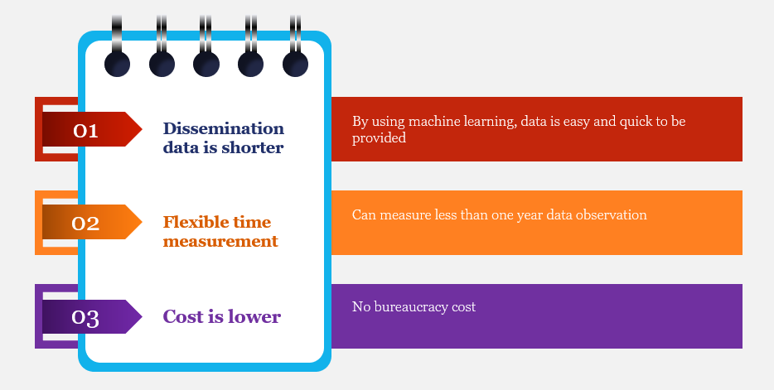
Advantage of Sentiment Analysis

Slide 24
Time Comparation
Democracy Index |  | Sentiment Analysis
Step | Time | Step | Time
Collecting data | One year | Collecting data | 2 days
FGD | 5 months | Modeling | 7 days
Deep Discussion | 1 month | Disemmination Data | 1 day
Classification check | 5 months
Counting index | 1 month
Total | 12 months | Total | 10 days

Slide 25
Cost Comparation
Democracy Index |  | Sentiment Analysis
Step | Source | Step | Source
Collecting data | - 365 newspapers | Collecting data | computer
FGD | - Hotel - Baverages - Speaker Accomodation | Modeling | computer
Deep Discussion | Speaker Accomodation | Disemmination Data | computer
Counting index | computer

Slide 26
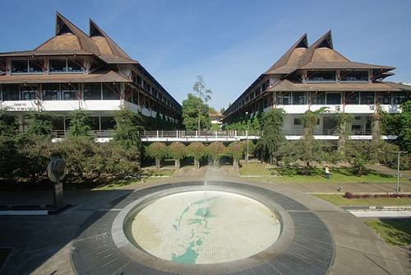
Big things have small beginnings
Lawrence of Arabia

